Slide 1
Table Of Contents
Sr. No. | Description | Page No.
1 | Problem Statement | 2
2 | Data Profiling & Cleaning | 3
3 | Exploratory Data Analysis | 4,5,6,7
4 | Preparing Data For Executing Model | 8
5 | Linear Regression Model | 9
6 | Logistic Regression Model | 10
7 | Decision Tree & Random Forest | 11
8 | Conclusions | 12
9 | Inferences | 13

Slide 2
Problem Statement: Analysing the FIFA project w.r.t. Target Variable ‘Man of the Match’ using Machine Learning Foundation Models

Slide 3
Data Profiling & Cleaning
The data set has total 128 rows & 27 columns including date column.
Out of 27 columns- 06 are ‘Object’ Columns, 03 are ‘Float64’ Columns & 18 are ‘Int64’ columns.
After profiling of data- columns(‘1st Goal’ , ‘Own Goal’ & ‘Own Goal Time’) having missing values (NAN) replaced by ‘zero’ values and ‘Date’ column converted to ‘datetime64’ format as it cannot participate in analysis.
Thus Data made usable for EDA

Slide 4
Exploratory Data Analysis
The Target variable identified as ‘Man of the Match’
There total 64 ‘Yes’ & 64 ‘No’ for Target Variable.
Highly Co-related variables are as below-
Ball Possession % Vs Distance Covered (Kms)- 0.88
Own Goal Vs Own Goal Time- 0.84
Goals in PSO % Vs Distance Covered (Kms)- 0.72
Attempts Vs Blocked – 0.75
Attempts Vs Off Target – 0.72
Attempts Vs On Target – 0.73
Attempts Vs Corners – 0.69
Corners Vs Blocked- 0.64

Slide 5
Exploratory Data Analysis
Highly Co-related variables Continued-
Passes Vs Attempts – 0.58
Passes Vs Corners – 0.53
Passes Vs Blocked – 0.52
Passes Vs Ball Possession % – 0.88
Pass Accuracy % Vs Ball Possession % – 0.71
Blocked Vs Ball Possession % – 0.52
Yellow Card Vs Fouls Committed – 0.43
Ball Possession % Vs Off Target- 0.36
Ball Possession % Vs On Target- 0.36
1st Goal Vs Goal scored- 0.28

Slide 6
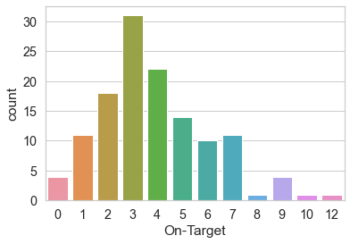
Exploratory Data Analysis
Number Of times any team hit the ball on target represented by bar chart-

Slide 7
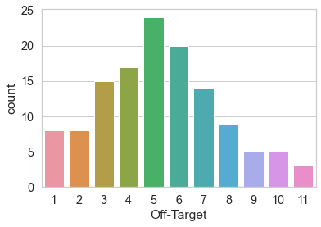
Exploratory Data Analysis
Number Of times any team hit the ball off target represented by bar chart-

Slide 8
Preparing Data For Executing Model
Data frames for Numerical & Categorical features created
Numerical Features are- 'Goal Scored', 'Ball Possession %', 'Attempts', 'On-Target', 'Off-Target', 'Blocked', 'Corners', 'Offsides', 'Free Kicks', 'Saves', 'Pass Accuracy %', 'Passes', 'Distance Covered (Kms)', 'Fouls Committed', 'Yellow Card', 'Yellow & Red', 'Red', '1st Goal', 'Goals in PSO', 'Own goals', 'Own goal Time'
Categorical Features are- 'Team', 'Opponent', 'Man of the Match', 'Round', 'PSO‘
Target Variable Identified as ‘Man of the Match’
All the Numerical Features transformed to ‘Standard Scale’
All the Categorical Features transformed to Numerical values by One Hot Encoding
Date Column dropped as it won’t impact analysis
Data split into ‘Explanatory Variables’ & ‘Exploratory Variable’
X= [All columns except 'Man of the Match_Yes'])- Explanatory Variables
y= ['Man of the Match_Yes']- Exploratory Variable.
The Data split for 20% Test & 80% Train

Slide 9
Applying Linear Regression Model
Linear Regression model imported, applied & Intercepts and Coefficients are drawn.
Accuracy of the model calculated after importing Sklearn.metrics
Mean Absolute Error
For training set is 8.087212816632268e-16 & for test set is 0.0013671109275314624
Mean Square Error
For training set is 1.0802125661413335e-30 & for test set is 1.6197933164142666e-05
Root Mean Square Error
For training set is 1.0393327504420003e-15 & for test set is 0.004024665596561118
R2 Score
For train is 1.0 & For test is 0.9999352082673434
Adjusted R2 Score
For train is 1.0 & For test is 1.0000234752654553
Except R2 & Adjusted R2 all other Metrics showing difference between error’s of Test & Train Data.

Slide 10
Applying Logistic Regression Model
Logistic Regression model imported, applied & Accuracy are drawn.
Accuracy score for train data is: 1.0
Accuracy score for test data is: 0.9615384615384616
After Applying Confusion Metrics-
Accuracy for Model in view of confusion metrics is- 0.9615384615384616
Accuracy Score after applying probability > 75% is 1.0
Accuracy Score after applying probability > 25% is 0.9615384615384616
Logistic Regression Model seems providing good results in terms of accuracy score & Confusion metrics values.
 | Predicted MOM_Yes | Predicted MOM_No
MOM_Yes_Actual | 12 | 1
MOM_No_Actual | 0 | 13

Slide 11
Applying Decision Tree & Random Forest Classifier Model
In Decision Tree classifier, after applying Grid Search CV
Grid’s Best Score- 1.0
Accuracy Score for Test Data- 1.0.
After Applying Random Forest Classifier-
Accuracy score for test data using the model without parameter specification: 1.0
Accuracy score for test data using the model with parameter specification: 1.0

Slide 12
Conclusions:
Linear Regression Model should not be applied For FIFA Dataset as it's Target Variable is in Categorical Boolean Variable.
Logistic Regression, Decision Tree & Random Forest Classifier models work properly with Accuracy Score nearly 1.0

Slide 13
Inferences:
‘Linear Regression’ should not be applied to dataset having Categorical Boolean target variable. Here Data is overfitted as ‘Test Data Set’ Accuracy > ‘Train Data Set’ Accuracy for MAE, MSE & RMSE metrices.
‘Logistic Regression’, ‘Decision Tree’ & ‘Random Forest Classifier’ any of the model work properly with Accuracy Score nearly 1.0

